Slide 1


SOFTWARE ENGINEERING
CASE STUDY PRESENTATION
Presented by:
Tong Nguyen Khang - 522K0034
Huynh Tuan Hao - 522K0019
Group 4

Slide 2

RESTAURANT INFORMATION SYSTEM
A case study of the KTPHAM cafe/restaurant

Slide 3



PROJECT CONTEXT
KTPham restaurant has recently expanded, from a capacity of 50 people 150 people.
However, the owner of KTPHAM has realized that the current manual is not efficient enough.
Owner wants to introduce an information system to assist in daily operations.

Slide 4






CURRENT PROCESSES PAIN POINTS
PAIN POINT 1
PAIN POINT 3
The current order taking process and kitchen communicating is manual and inefficient.
PAIN POINT 2
There are currently no way for customers to access the menu online. Reservation are also not available to be booked online, instead manual.
PAIN POINT 4
Lack of statistical data on menu items, leading to no clear overview of dishes performances.
Manual invoices and payments handling proves to be in need of renovation.

Slide 5





PROJECT GOALS AND OBJECTIVES
Statistical data of dishes performances for analysis and menu improvements.
Accurate, reliable and responsive customers payment handling system.
Modernized and efficient order and kitchen management system.
An online presence in the form of online menu access and reservations.

Slide 6
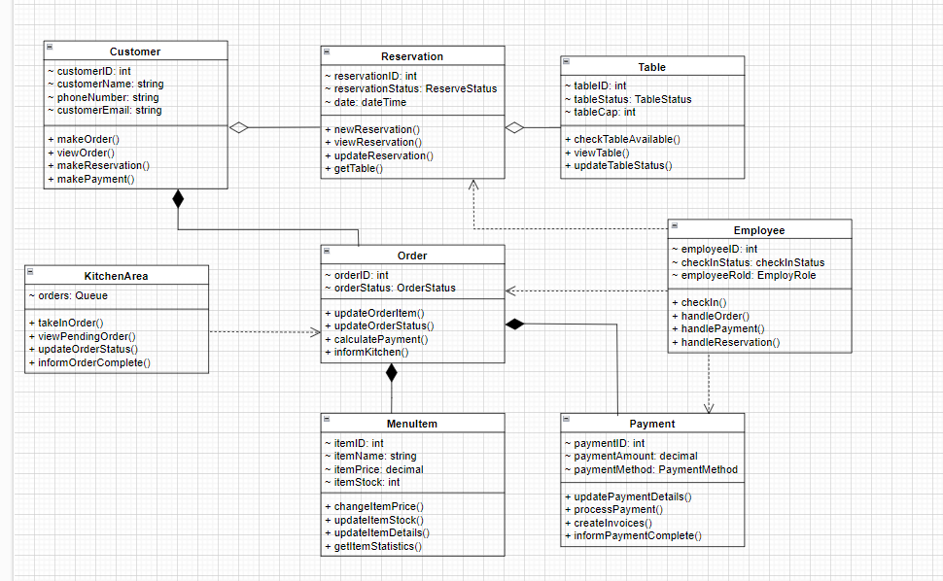
CLASS DIAGRAM
Core classes of the project:
Customer
Employee
Order
MenuItem
KitchenArea
Reservation
Table
Payment

Slide 7

DESIGN PATTERNS
1
2
3
OBSERVER PATTERN
COMPOSITE PATTERN
STATE PATTERN
Identified in: Order-KitchenArea relationship.
Implementation: Order (Subject) notifies KitchenArea (Observer) of changes through the dotted line dependency.
Justification: Needed for real-time updates when orders are placed or modified, allowing the kitchen to automatically receive notifications without constant polling.
Identified in: Order-MenuItem relationship (shown by double composition).
Implementation: Order can contain multiple MenuItems.
Justification: Allows orders to be treated as collections of menu items, simplifying order management and calculations.
Evident in:
+ Order (orderStatus: OrderStatus)
+ Table (tableStatus: TableStatus)
+ Reservation (reservationStatus: ReserveStatus)
Justification: Manages different states of orders, tables, and reservations cleanly, allowing for proper state transitions

Slide 8
DESIGN HEURISTICS
1
2
3
HIGH COHESION
INFORMATION EXPERT
LOW COUPLING
Demonstrated by: Use of dependency relationships (dotted lines) instead of direct associations).
Implementation: Employee to Order/Reservation/Payment relationships.
Justification: Allows for more flexible and maintainable code by reducing interdependencies.
Applied to: All classes (each has a specific, focused purpose).
Examples:
+ KitchenArea focuses solely on kitchen operations
+ Payment handles only payment-related functions.
Justification: Makes system more maintainable and easier to modify.
Applied to: MenuItem class
Implementation: MenuItem contains all item-related information and calculations.
Justification: Places responsibility for menu item information and pricing where the data resides.

Slide 9
DESIGN HEURISTICS
4
5
PROTECTED VARIATIONS
CREATOR PATTERN
Applied to: Payment class (paymentMethod: PaymentMethod)
Implementation: Encapsulates different payment methods.
Justification: Shields system from changes in payment processing methods.
Applied to: Customer creating Orders
Implementation: Shown through composition relationship.
Justification: Customer naturally responsible for creating their orders.

Slide 10
CRC CARDS
Class | Description | Responsibilities
Customer | Acts as the primary user interface for all dining-related interactions in the restaurant system | + Place food orders and modifications (Order, MenuItem & Employee) + View current order status and details (Order) + Make restaurant reservations (Reservation & Table) + Make payments for orders (Payment & Employee) + View order history and past transactions (Order) + Update customers information (None)
Reservation | Coordinates the booking system to ensure efficient table utilization and customer seating arrangements | + Create new reservations (Customer & Table) + View current reservations (Customer & Table) + Update reservation status and details (Employee) + Get tables current statuses (Table) + Send confirmation notifications (Customer) + Handle reservation modifications (Customer & Table)

Slide 11
CRC CARDS
Class | Description | Responsibilities
Table | Serves as a core resource management unit for the restaurant's physical seating arrangements | + Monitor and update table availability (Reservation) + Track table capacity and status (None) + Assign tables to reservations (Reservation) + Update table status for cleaning/maintenance (Employee)
Order | Functions as the central hub for managing the entire food service transaction cycle | + Create new orders (Customer & Employee) + Add/remove menu items from order (MenuItem) + Calculate total amount with modifiers (MenuItem) + Process order modifications (Employee & KitchenArea) + Track order status through system (KitchenArea & Employee) + Generate order summary and details (MenuItem) + Link orders to table reservations (Table) + Inform kitchen of new orders (KitchenArea)

Slide 12
CRC CARDS
Class | Description | Responsibilities
KitchenArea | Serves as the command center for food preparation workflow and order fulfillment | + Receive and queue new orders (Order) + Track order preparation status (Order) + Update order status in system (Order) + Manage item availability (MenuItem) + Process special requests (MenuItem) + Inform staff of completed orders (Employee)
Employee | Acts as the operational executor handling all staff-related activities and customer service functions | + Track employee check-in/out status (None) + Process and modify customer orders (Order & MenuItem) + Handle customer payments and refunds (Payment) + Manage table assignments (Table) + Handle reservation requests (Reservation) + Update order and table status (Order & Table)

Slide 13
CRC CARDS
Class | Description | Responsibilities
MenuItem | Functions as the fundamental building block of the restaurant's menu and ordering system | + Maintain price information (None) + Check if items are available (KitchenArea) + Calculate item total with modifiers (Order) + Provide item description and details (None) + Manage items popularity statistics (Order) + Update amount of items in stock (None)
Payment | Operates as the financial transaction processor and record keeper for all monetary operations | + Handle customers payment methods (Order) + Generate receipts and invoices (Order) + Calculate the amount of customer bills (Order & Customer) + Update invoices details and statuses (Employee & Order) + Apply discounts to invoices (Employee) + Inform the customers of the completion of payment (Customer) + Create financial reports (Order)

Slide 14
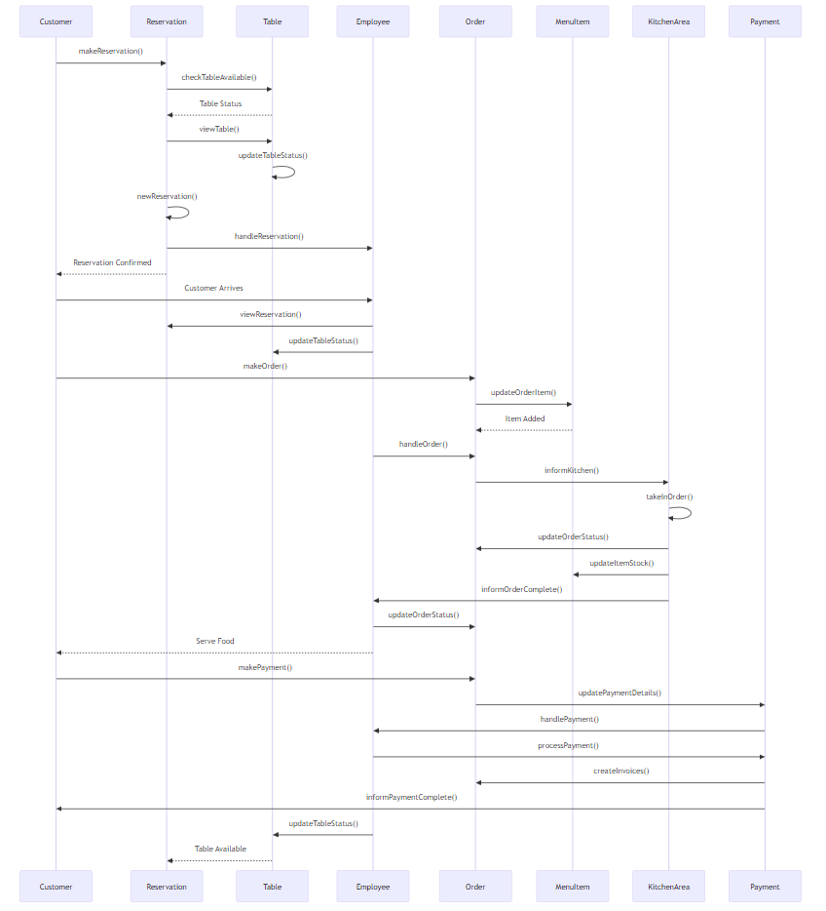
WORKFLOW DIAGRAM

Slide 15
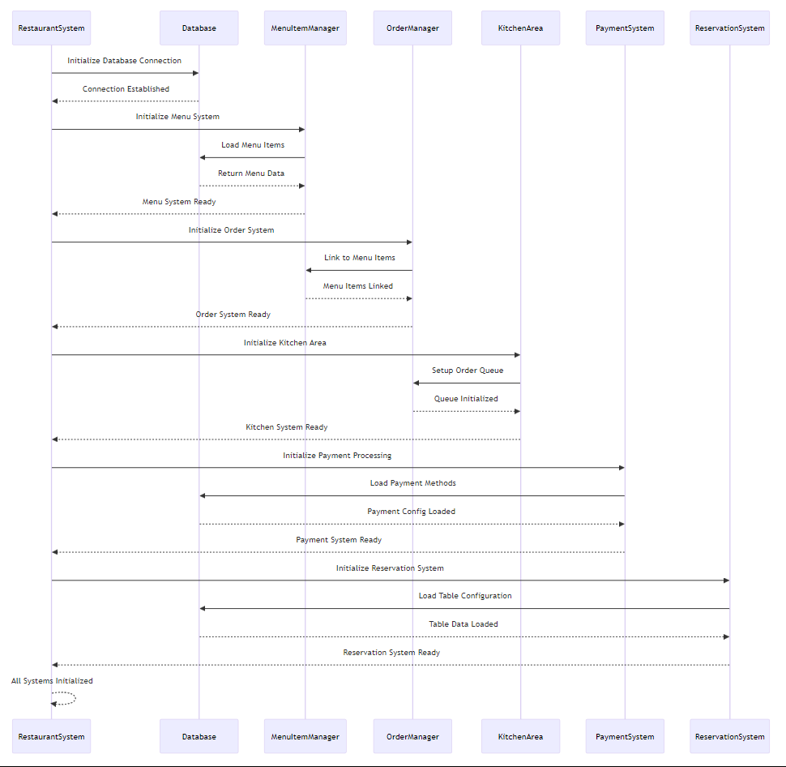
SYSTEM BOOTSTRAP PROCESSS

Slide 16
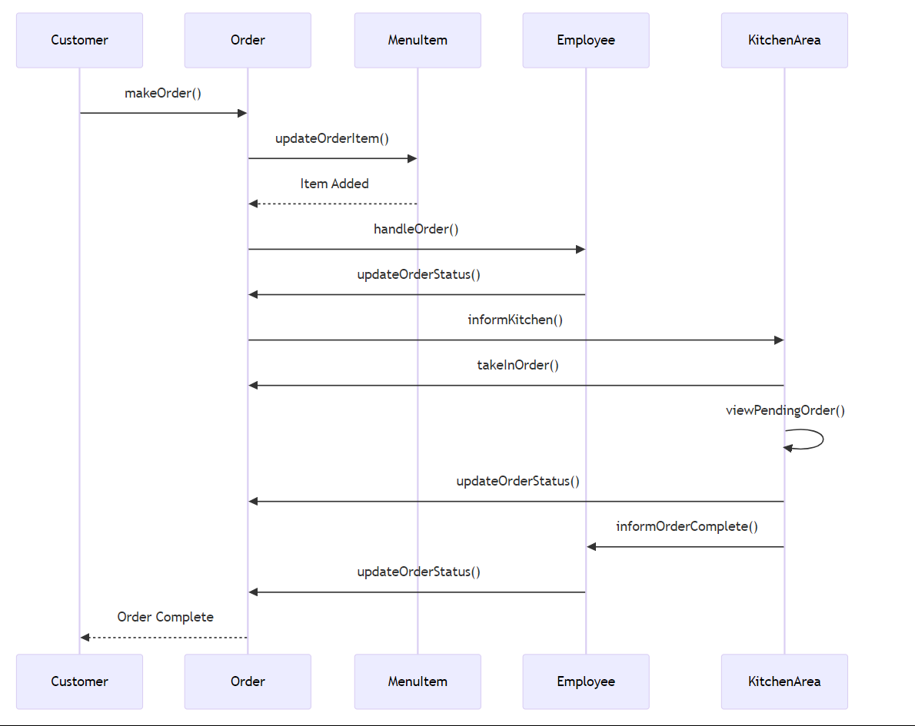
SCENARIO: CUSTOMER ORDERING

Slide 17
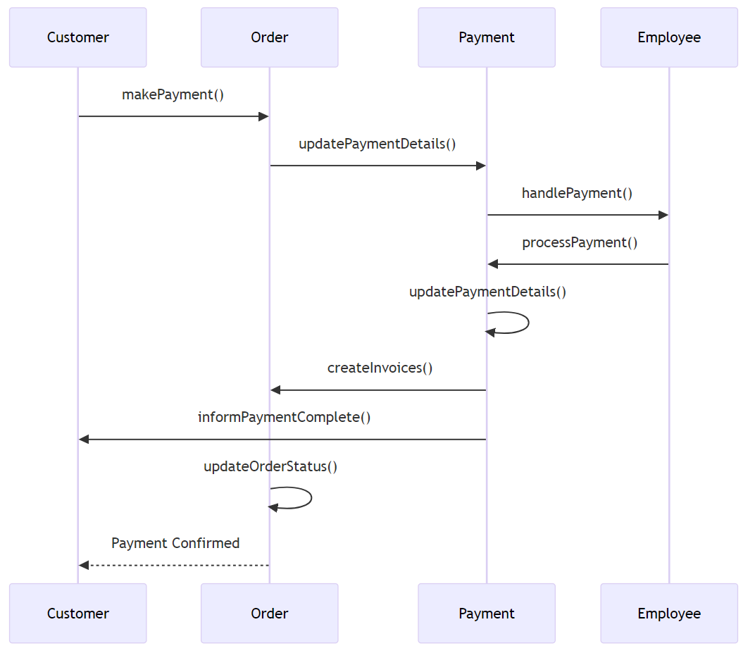
SCENARIO: PAYMENT PROCESSING

Slide 18
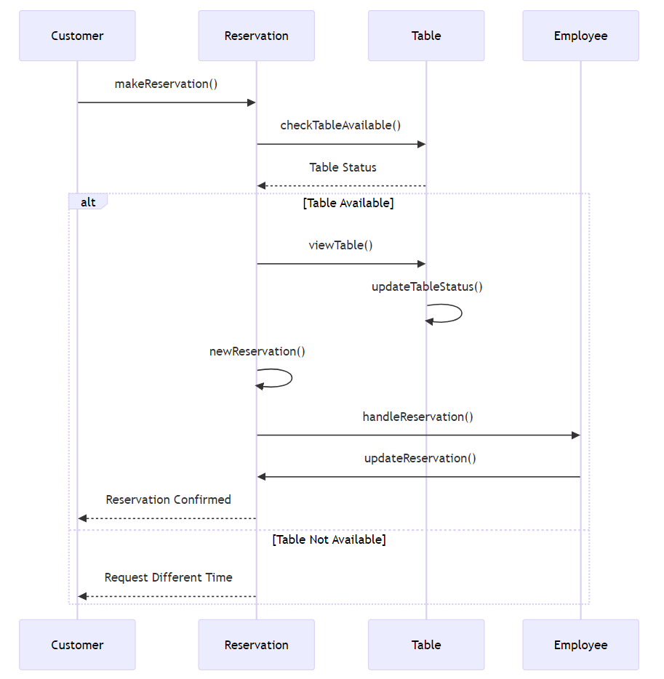
SCENARIO: MAKING RESERVATION

Slide 19
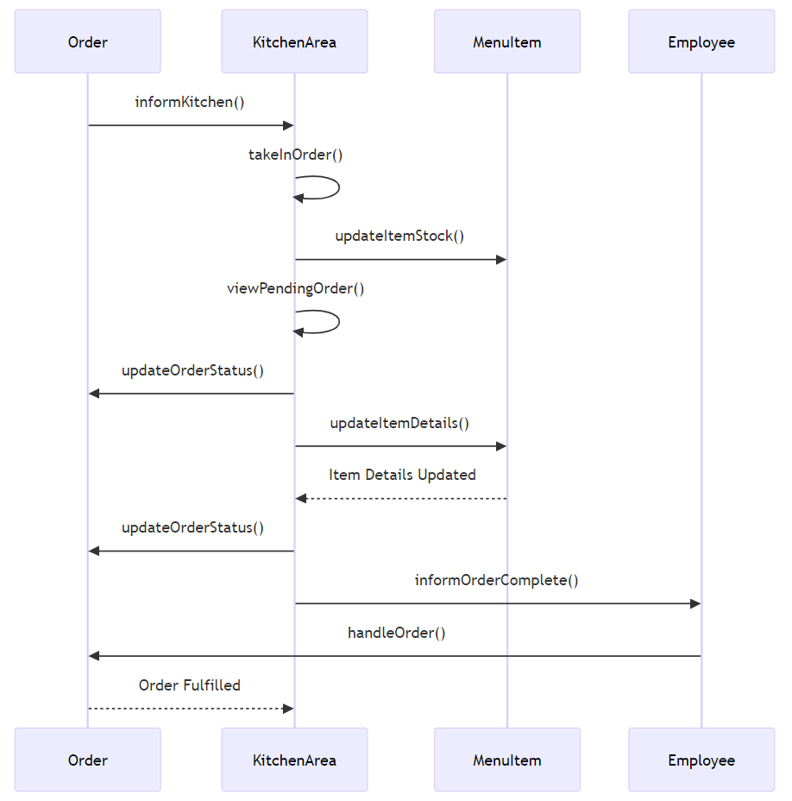
SCENARIO: KITCHEN ORDER MANAGEMENT

Slide 20


THANK
YOU
FOR YOUR TIME AND ATTENTION

